Slide 1
Las Palabras 1.2
El banco --------------------bank
El supermercado ---------grocery store
La gasolínera ------------- gas station

Slide 2
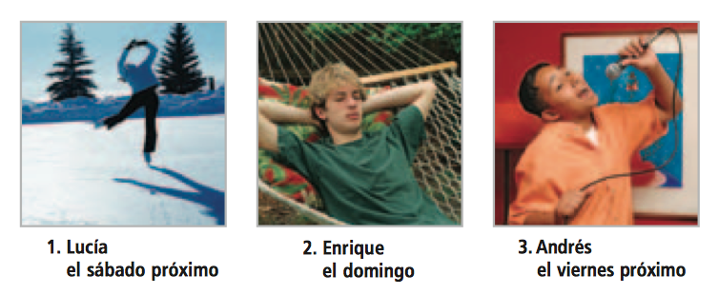
Bell Work 3.2 Write a sentence in Spanish that says what each person is going to do and when.

Slide 3
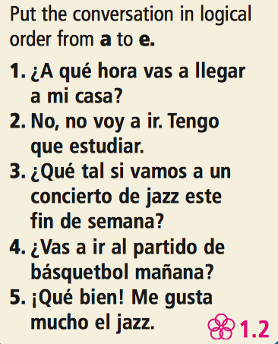
Bell Work 2.2

