Slide 1
Las Palabras 29.2
El ático -----------------------attic
La ducha --------------------shower
El espejo ---------------------mirror

Slide 2
Bell Work 1.3
Describe who does the following chores in your family and indicate how often.
MODELO: Mi padre casi siempre corta el césped.
hacer la camas
Arreglar la sala
Sacar la basura
Cuidar a los hermanos
Limpiar la cocina

Slide 3
Bell Work 2.3
Create a question for each of the following answers:
Cuatro habitaciónes
Grande
Él lava los platos.

Slide 4
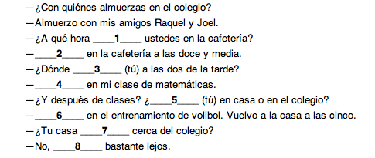
Bell Work 3.3 Complete the following conversation with the correct form of the verb estar:

Slide 5
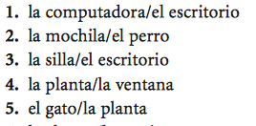
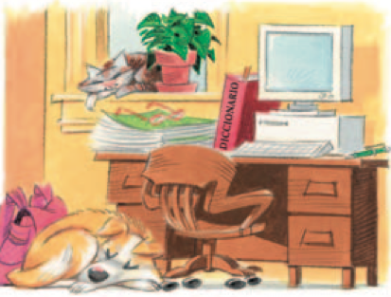
Bell Work 4.3 Looking at the picture, write a sentence describing the relationship between the two objects.

