Slide 1
Las Palabras 4.4
La mostaza ------------mustard
Los fideos--------------noodles
El mantel--------------table cloth

Slide 2
Bell Work 5.4
Write 3 things that you learned about Mexico’s tradition of Semana Santa.

Slide 3
Bell Work 6.4 Indicate what you need to eat each food. Choose 5.

Slide 4
Bell Work 7.4
How would you say the following in Spanish?
Tell the server you would like a flan
Say that the soup is a little spicy.
Say that the fries are delicious.

Slide 5
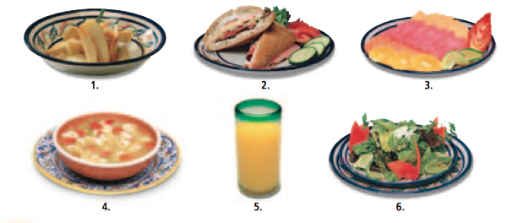
Bell Work 8.4 You are in a restaurant and the waiter asks you how everything is. Answer him.

