Slide 1
7.9 No hay escuela

Slide 2
Palabras 8.9
Ocupado ------busy
Irritado------irritated
Turquesa-----turquoise

Slide 3
Bell Work 9.9
Write the subject pronoun you would use for the following people:
I
She
Rosa and I
Juan and Lupe
Señora Holick

Slide 4
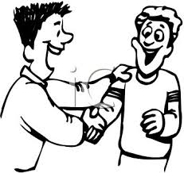
Bell Work 11.9
Write a brief conversation between the two men in the picture

Slide 5
Bell Work 10.9
How do you ask your principal or her name?
How do you say “see you soon” in Spanish?
What is the Spanish for “Mr.?”
What is the subject pronoun for “they (all females)?”
What is the subject pronoun for “we?”

