Slide 1
España

Slide 2
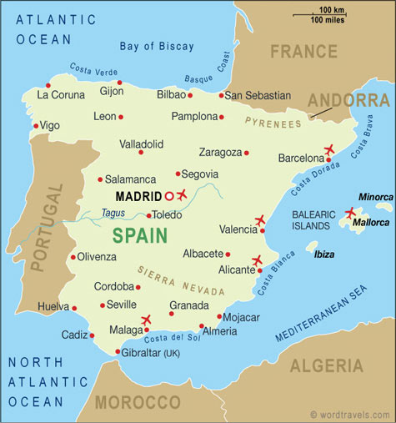

Slide 3
Flamenco
*Originated in Andalucía in Southern Spain
*Gypsies played a major role in its origins
*Important elements:
-Guitar
-Dance
-Singing
-Castanets (hand-held rhythmic devices which are clapped together)
Flamenco Dancing

Slide 4
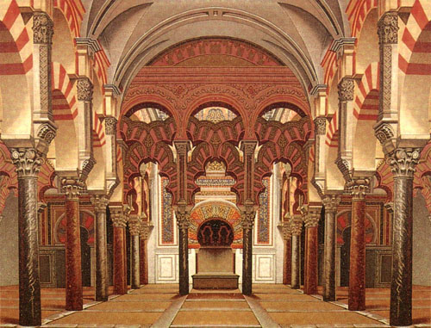
La Historia
*La Mezquita is a former mosque in the city of Córdoba. It shows the Arab influence on the city.

Slide 5
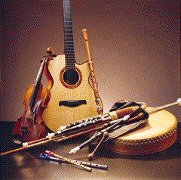
La Historia
*The musical instruments in Galicia demonstrate the Celtic roots, as they were the first to settle there.

Slide 6
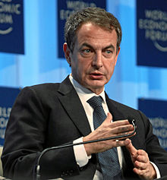
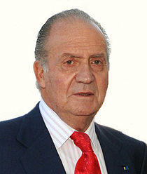
Gobierno
*Spain is a parliamentary monarchy
*José Luis Rodríguez Zapatero has
been the prime minister since
April 17, 2004.
*Juan Carlos I has been the king of
Spain since November 22, 1975.

Slide 7
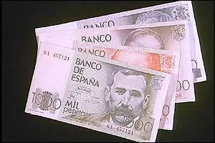
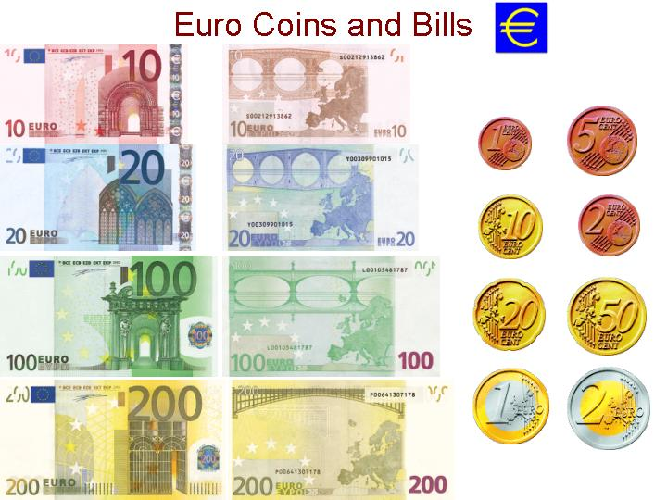
Dinero
*The peseta was the currency
used in Spain from 1869 and 2002.
*In 2002, Spain introduced
the euro as the official
currency of Spain, as
did many other countries
in Europe.

Slide 8
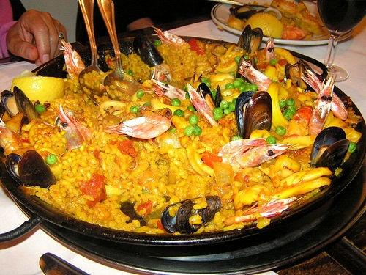
Comida
*Paella is a common dish in Spain.
*It is made of rice, vegetables,
seafood, chicken, and sausage.
(or any variety of those)

Slide 9
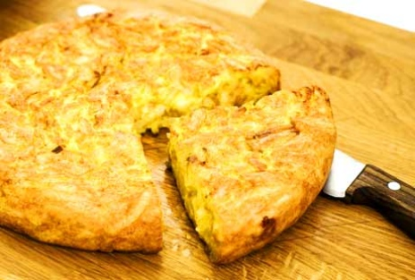
Comida
*LA TORTILLA ESPAÑOLA*
*In Spain, a “tortilla” is an omelet made with eggs, onions, and potatoes.

Slide 10
Greetings
*In Spain, it is common for friends
and family members to greet
each other with two kisses,
one on each cheek.
*In a professional setting or when
meeting someone for the first
time, the common greeting is a
handshake.

Slide 11
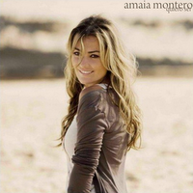
Música- Amaia Montero
*Born in Basque Country, Spain in 1976
*Met the group members for her band, La Oreja de Van Gogh during college
*Was with the band for 11 years
*Decided to go solo in 2007
*Has sold more than 7 million albums worldwide

Slide 12
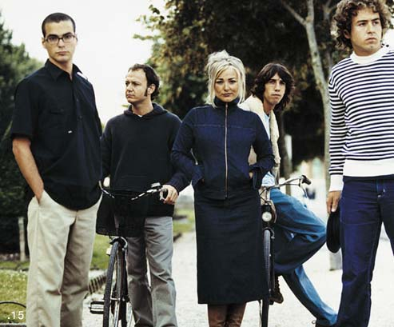
La Oreja de Van Gogh
*Group started in 1996 by 5 members
*Made 4 albums with original soloist, Amaia Montero
*When Montero left in 2007, the band found a new lead singer, Leire Martínez
*They have since released one album

Slide 13
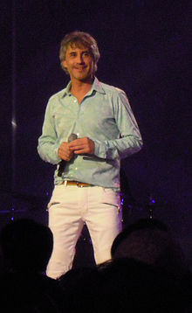
Serigo Dalma
*Spanish pop singer
*Born in Sabadell, Spain in 1964
*His career took off when he won a TV show
*Has released 16 albums since 1989

Slide 14
Poll
1st Period Poll
4th Period Poll
8th Period Poll

Slide 15
Ganador
Aquí Estoy- Amaia Montero y Camo
Cuídate- La Oreja de Van Gogh
Cuidaré- Sergio Dalma

