Slide 1
Speaking and listening
How to record yourself and listen to others.

Slide 2
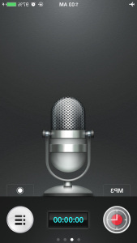
Step #1
Download the free app, Recordings Lite
Download a free QR code reader of your choice.

Slide 3
Step #2
Record yourself while completing your speaking assignment. You may hit pause if needed while speaking. Hit stop when finished.

Slide 4
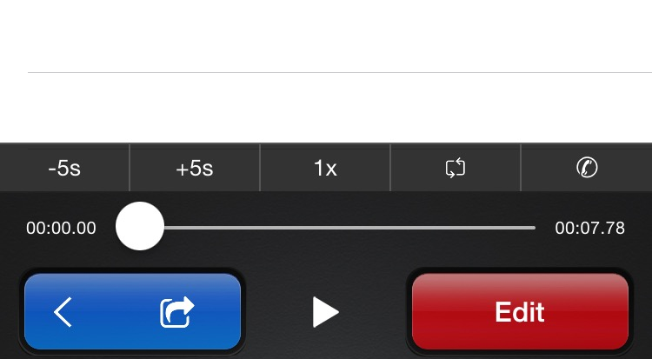
Step #3
Press the blue “share” arrow button when finished.

Slide 5
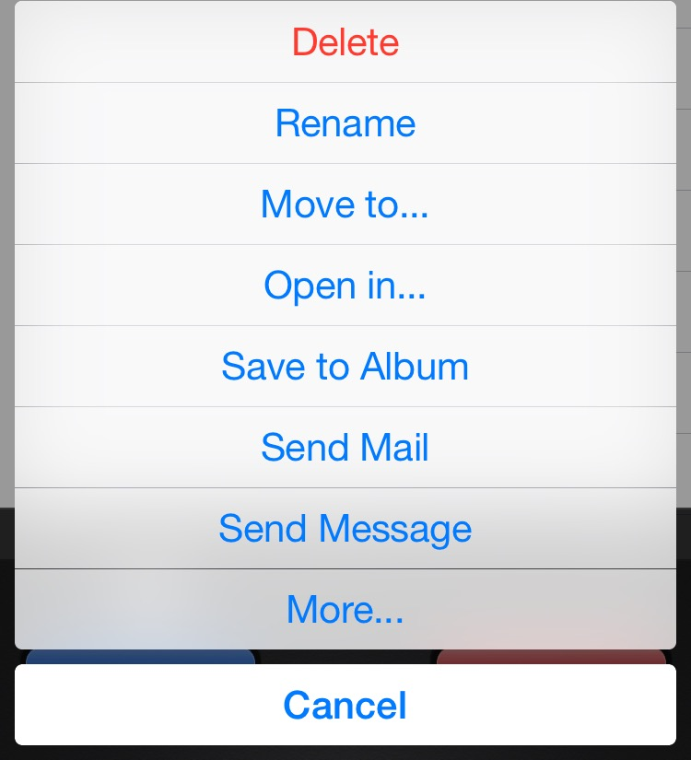
Step #4
Click on the link “Rename” and rename your recording with your last name.firstname

Slide 6
Step #5
Click on the blue “share” arrow button again.

Slide 7
Step #6
Hit the button “Send Mail” and send it to my email address: holick_bethany@dublinschools.net

Slide 8
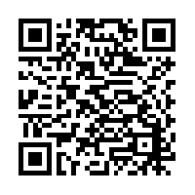
Step #7
After I receive your recording, I will link your recording to a QR code so you, your family, and your classmates can easily access your speaking assignment in order to hear your own voice in Spanish!!!

Slide 9
To Listen…Step #1
Scan the QR code of the person’s listening assignment you would like to hear.

Slide 10
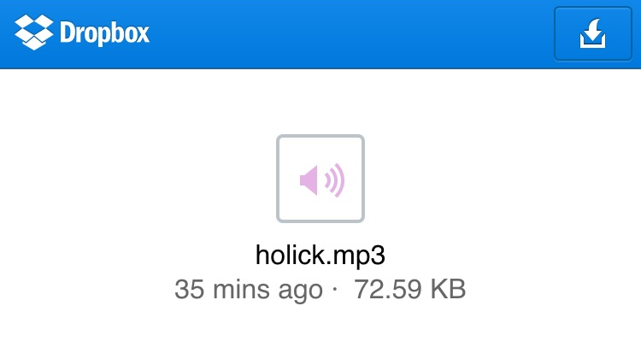
To Listen…Step #2
Click on the blue download arrow at the top right hand corner.

Slide 11
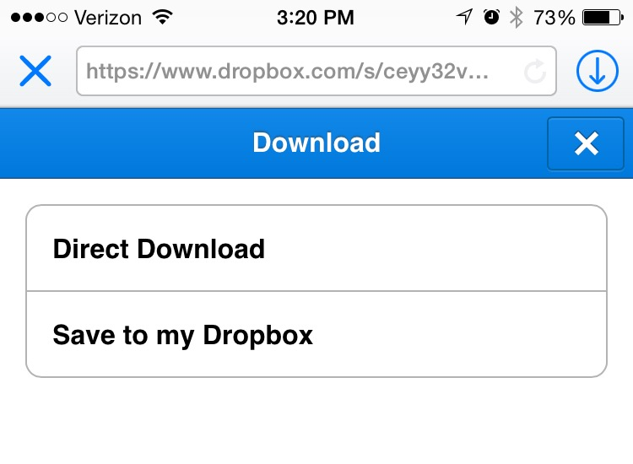
To Listen…Step #3
Click on “Direct Download”

Slide 12
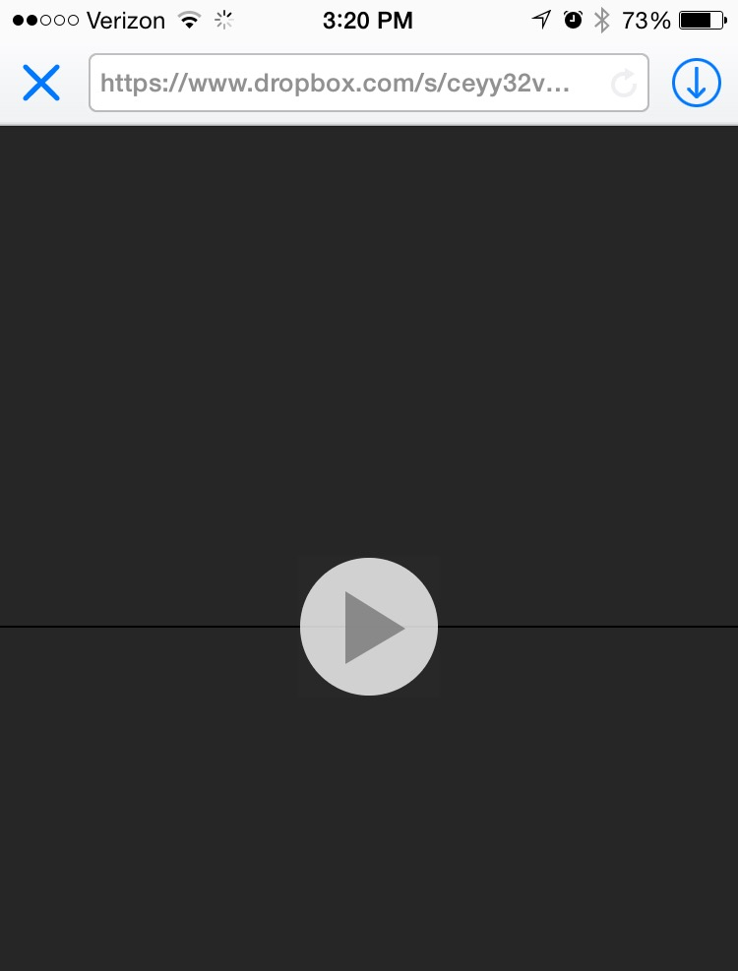
To Listen…Step #4
Press the “play” button and listen to the speaker. You may pause at any time while listening if needed.

